Slide 1
Dynamic Normalization Network
How can we achieve global image normalization through local (pixel-wise) interactions?
Could this mechanism account for some brightness/lightness illusions?

Slide 2
Differential equations
Differential equations allow for the computation of a system’s evolution based purely on the initial conditions and the defined dynamics of the system.
In this case, the diffusion equation satisfies the dynamics which we desire, that is, a spatially-discrete processing mechanism in 2D.
Within this equation, we can design operators which change the dynamics and in this way change how the system evolves.

Slide 3

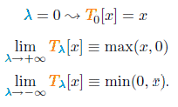
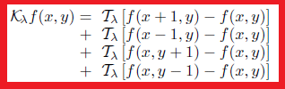
Diffusion equation prerequisites
The diffusion equation is steered to different dynamics by λ parameter.
This in turn dictates how the T operator functions.
T operator states either no operation, half-wave rectification or inverse half-wave rectification (to be discussed later).
K operator applies T operation to the nearest neighborhood of each pixel in the image.

Slide 4
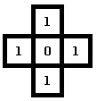
K operator walk-through
If we choose λ=-inf, then T(λ) becomes min(x,0) which operates upon the neighborhood of each pixel.
This operator asks “is x smaller than 0?”, if yes return x, if not return 0.
Using the local surround above, where (0,0)=0, we find Kf(0,0) = min(1,0)+min(1,0)+min(1,0)+min(1,0) = 0. Therefore local minimum is preserved.
If we choose λ=+inf, then T(λ) becomes max(x,0) and Kf(0,0) = 4, through the opposite computation. Therefore local minimum has been “eaten” or overwritten by the local surround.
In this way a local operation results in a global average. Either in the λ=-inf or λ=+inf states (or else can be described as the lightness diffusion layer and darkness diffusion layer)

Slide 5



The diffusion equation
K operator is a component of the full diffusion equation
Generic form of diffusion equation
Two diffusion states: “a” applies minimum operator (where, λ=-inf) upon local surround, “b” applies maximum operator (where, λ=+inf) upon local surround.
At time zero, the solution of the diffusion equation is simply the input stimuli, and as time evolves, the nearest neighborhood interactions develop the two diffusion layers a and b, “darkness and lightness diffusion layers”.

Slide 6
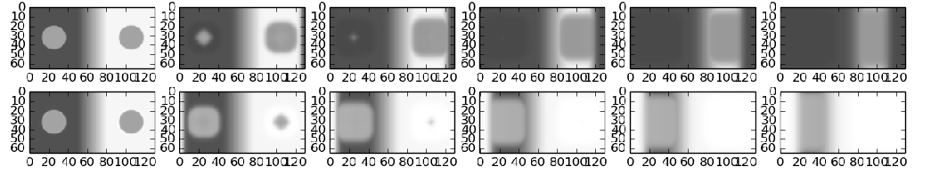
Visualising the diffusion layers
The diffusion equations are solved using the 4th order Runga-Kutta method (let me know if you want more in-depth explanation of this method, but in short it finds solutions). There are simpler ways to solve differential equations, but this is the most robust and accurate.
Below are some solutions to a&b, the diffusion state equations.
a
b
t
In a, the darkness diffusion layer, it can been seen that darker pixels “eat” lighter pixels resulting in the growth of local darkness.
In b, the lightness diffusion layer, it can be seen that lighter pixels “eat” darker pixels, resulting in the growth of local lightness.
From finding the “zero state luminance” (darkest value) and “one state luminance” (lightest value), we can go onto normalise the initial image.

Slide 7

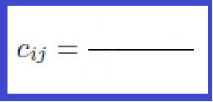

Recombining the two diffusion layers to generate a normalized image
The two diffusion equations (darkness diffusion layer, brightness diffusion layer) are then recombined to generate a normalized image, using the below equation.
Solving these equations we can put them into the linear scaling scheme and dynamic ”ON-type” normalization schemes
stimuli scaled to zero. i.e. subtract the minimum, a
luminance range between darkness and lightness layers (i.e. luminance range)

Slide 8

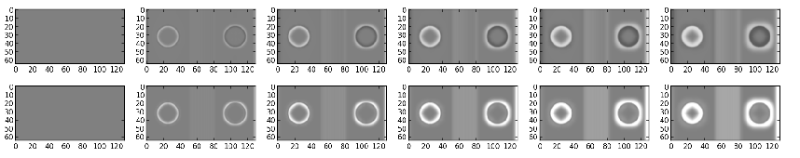
Change in normalized output over time
Here is plotted how c&d change over time. In this way we can observe the related lightness changes in each region. Dark being overall darkening, light being overall lightening.
Top steady-state , Bottom dynamic state

Slide 9
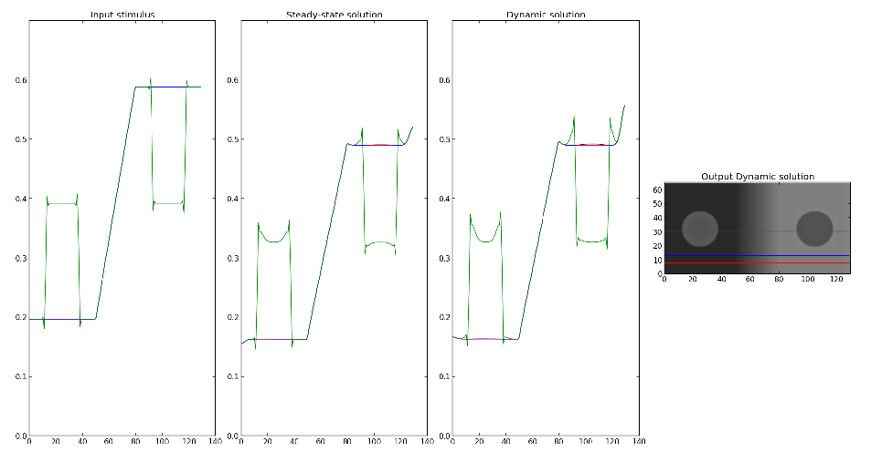
Profile of Outputs

Slide 10

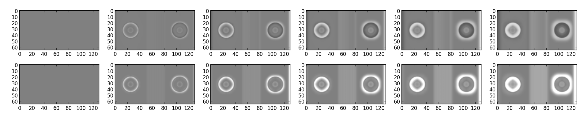
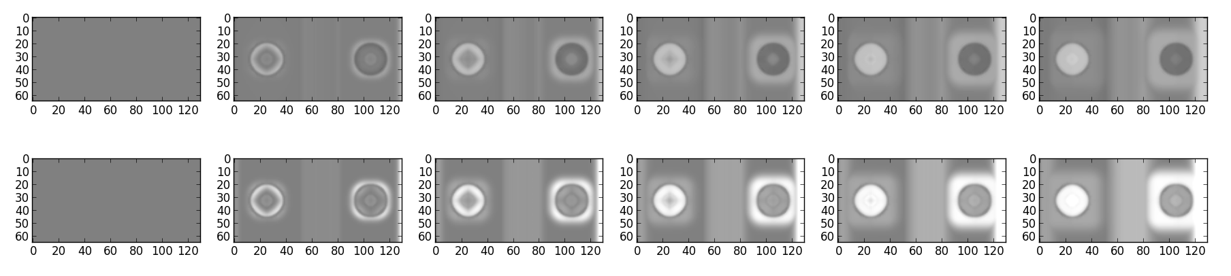
Internal patch
D=0.2
D=0.5

Slide 11
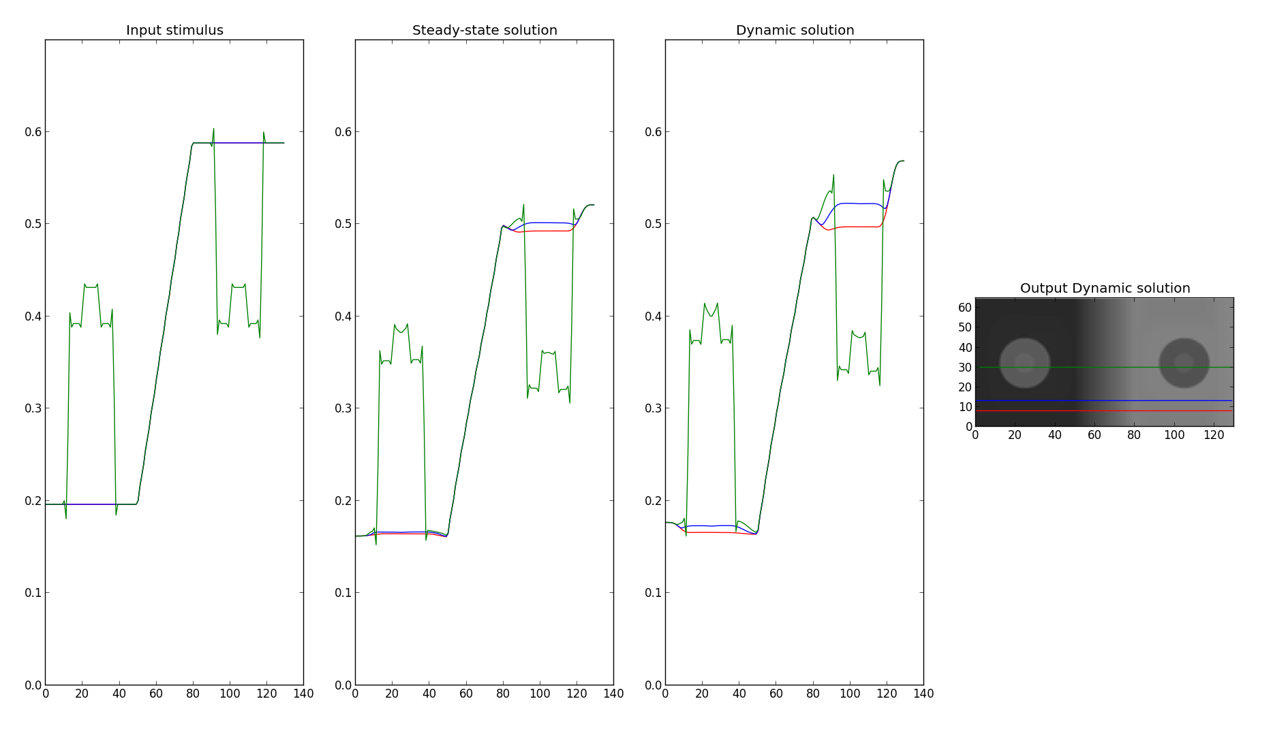
Internal Patch
D=0.5

Slide 12

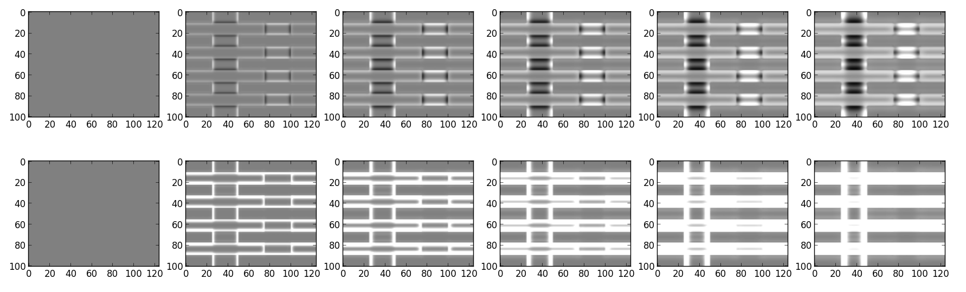
White's

Slide 13
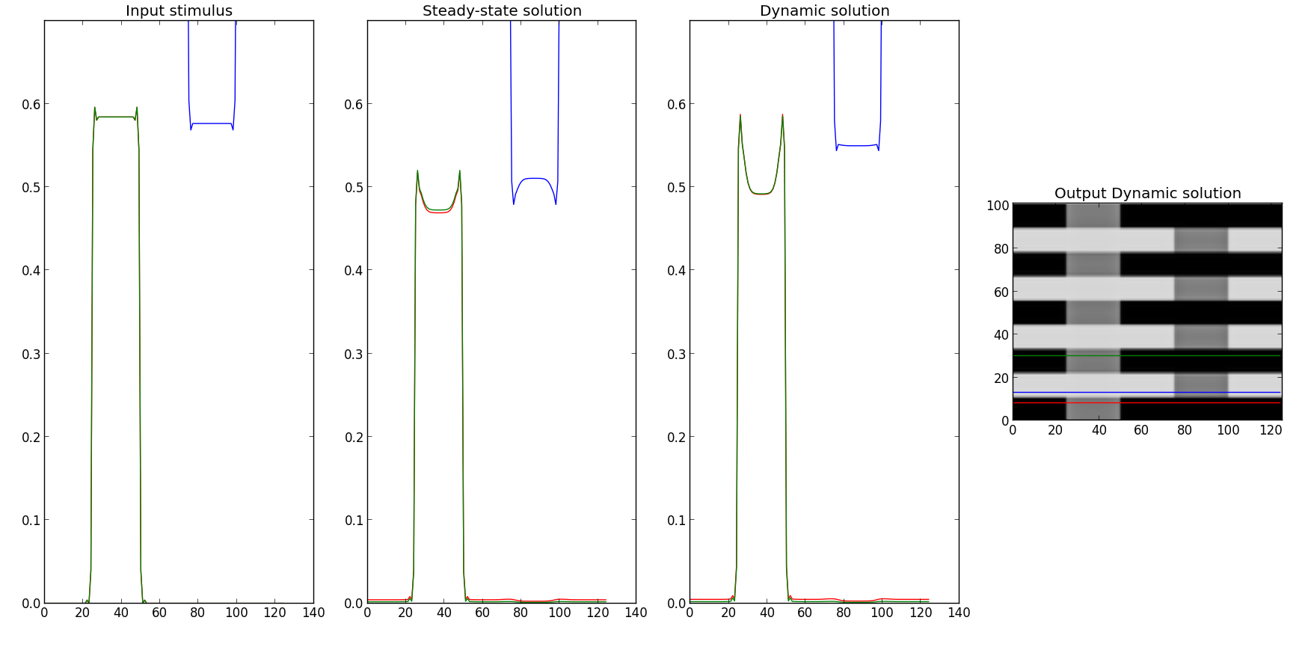
White's

Slide 14
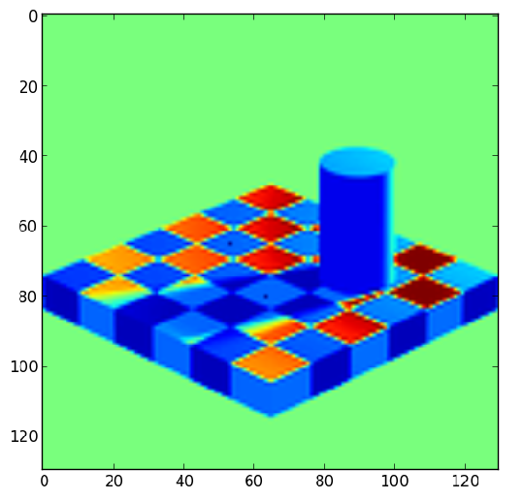
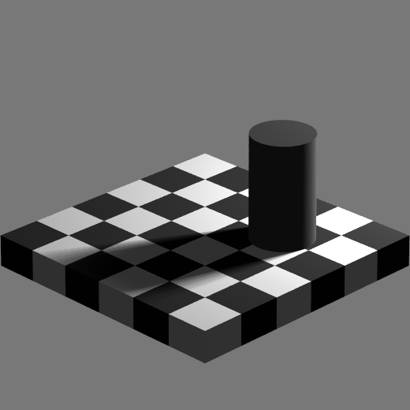
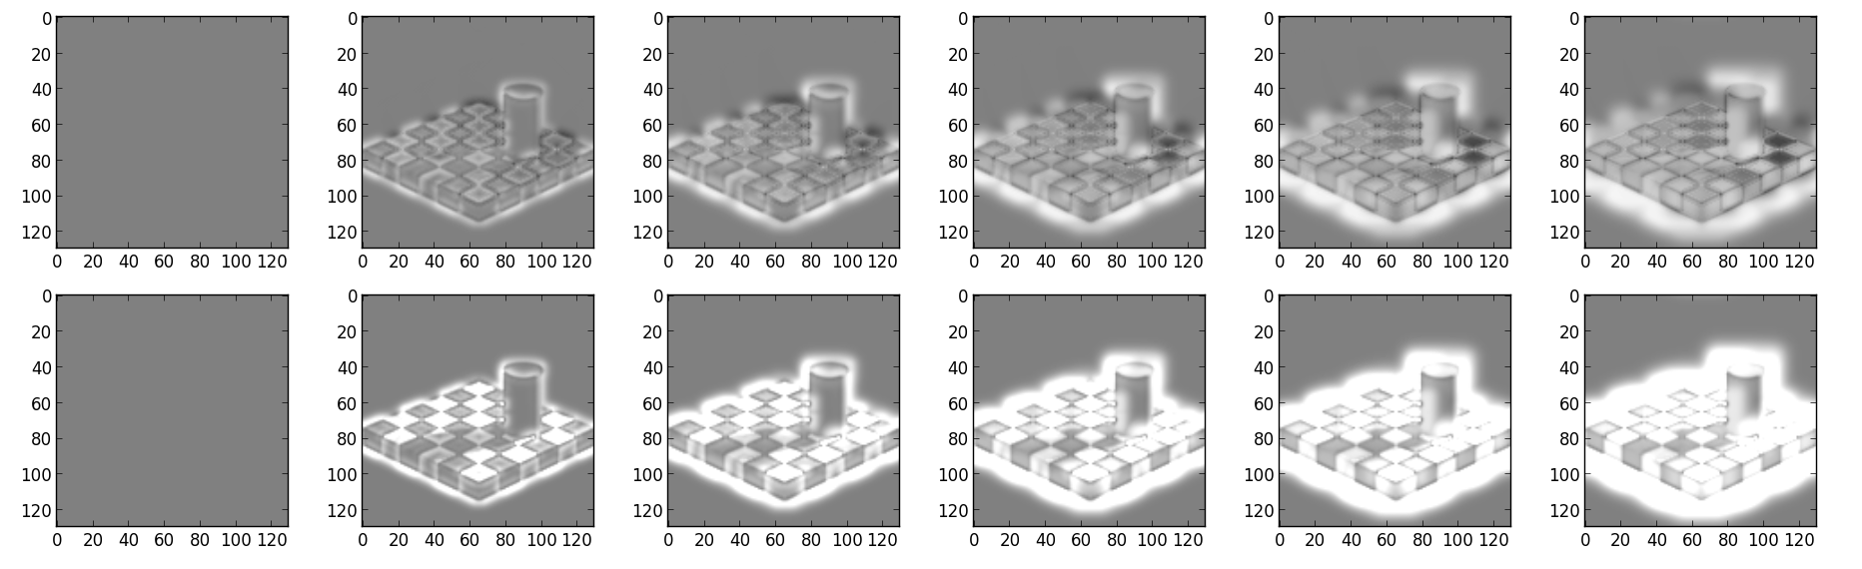
Adelson
No change in difference between test checks

Slide 15
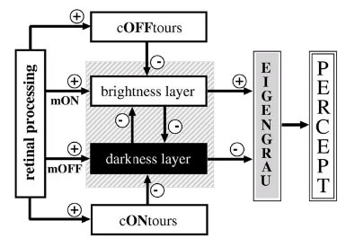
In context of full model
Viewed current output represent end point of normalization process or “brightness layer” diffusion filling-in, also ON-type contrast

Slide 16
Possible future work
Combined with edge detection & FIDO code from Francis model to average normalized change within edge domains
Expand model with cONtours & cOFFtours

Slide 17
Conclusions
Need to confirm stability of output at high diffusion coefficient values
Questionable neurophysiological plausibility
Fails for Adelson's & White's
Luminance information “fills-in” from contrast edges (see real world videos)
Lightness effects observed in SBC with inner patches

